Slide 1
Reflection

Slide 2
Vision
Autonomic
Self-* (management)
Configuration
Adaption
Healing
Tuning

Slide 3
Architectural reflection
VS. reflection i Java el. .NET
Structural vs. behavioral
Structure of the system
Aktiviteter
Procedural vs. declarative
Manipulation af systemet
Manipulation af abstraktion af systemet
Dyrt når systemer er nede -> autonome systemer

Slide 4
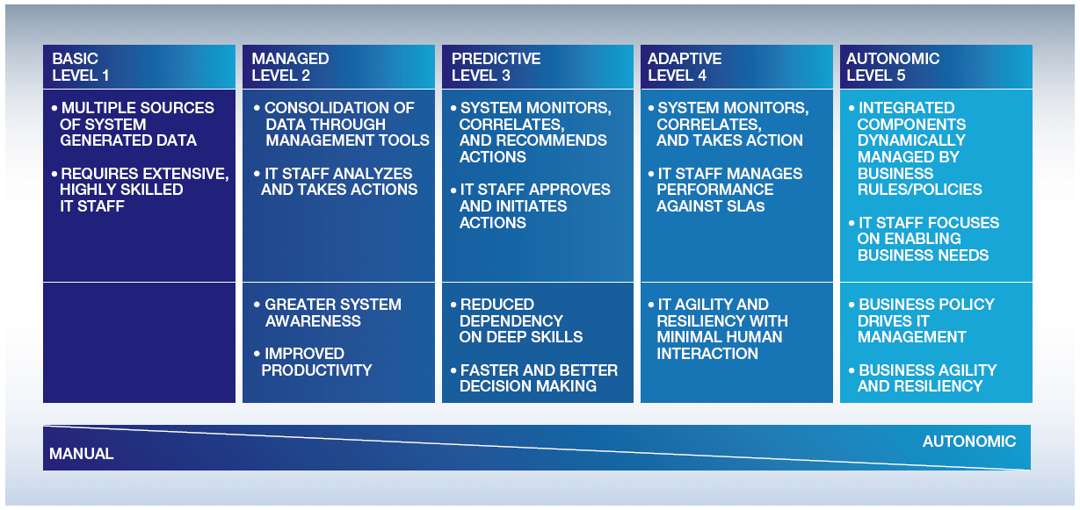
Autonomic computing axis

Slide 5
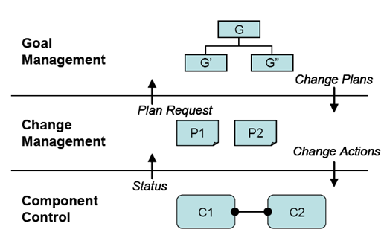
Autonomic systems

Slide 6
DiscoTect
Kan analysere et kørende system
probes
Kan bruges i 3-lags arkitekturen
Omdanne system events til architectural events

